Slide 1
Portfolio Analysis
Kumari Amrita, Renae Martinez, Heena Roy, Jatinder Singh
http://www.free-powerpoint-templates-design.com

Slide 2
Agenda
01
Project Overview
02
Portfolio Analysis Tools
03
Robo Advisor

Slide 3
Project Overview

Slide 4
Initial Investment Decisions
High Returns
Cool Company
Stable Company
Dividends
Low Returns
Market Corrections
Volatile News
Short-term Investment Mindset
BUY
SELL

Slide 5
Risk Discovery
Ratings
Beta
P/E Ratio
Profit Margin
Market Corrections

Slide 6
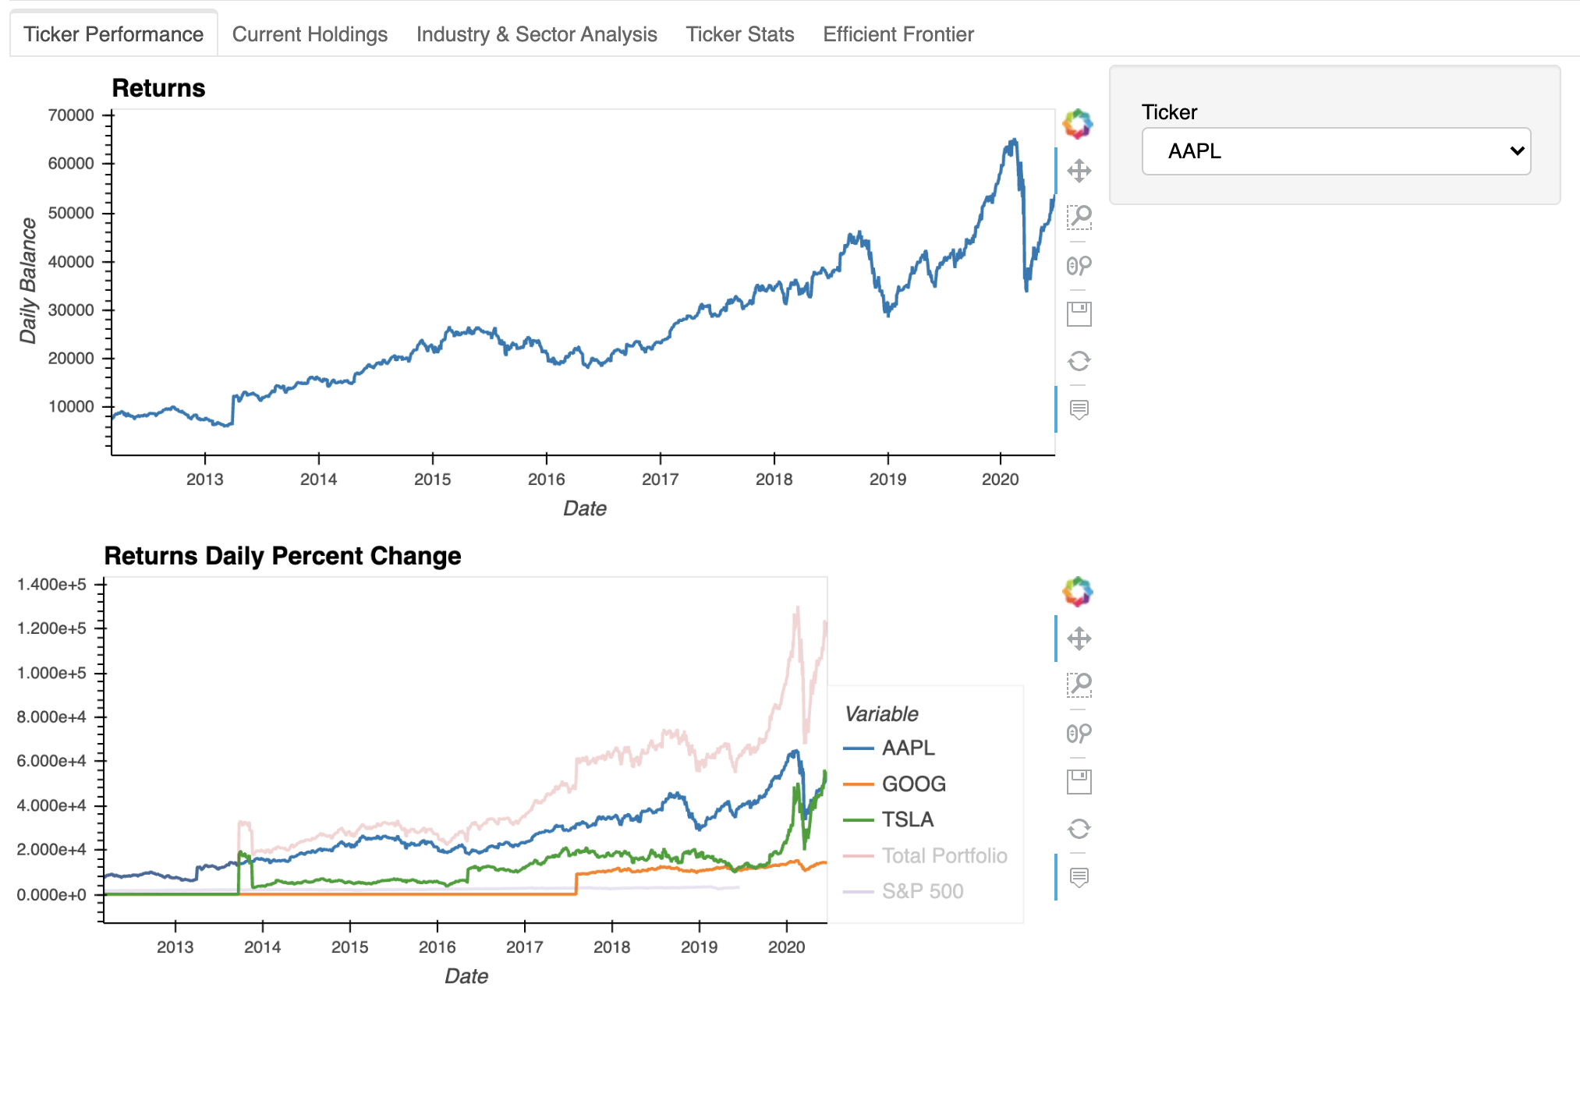
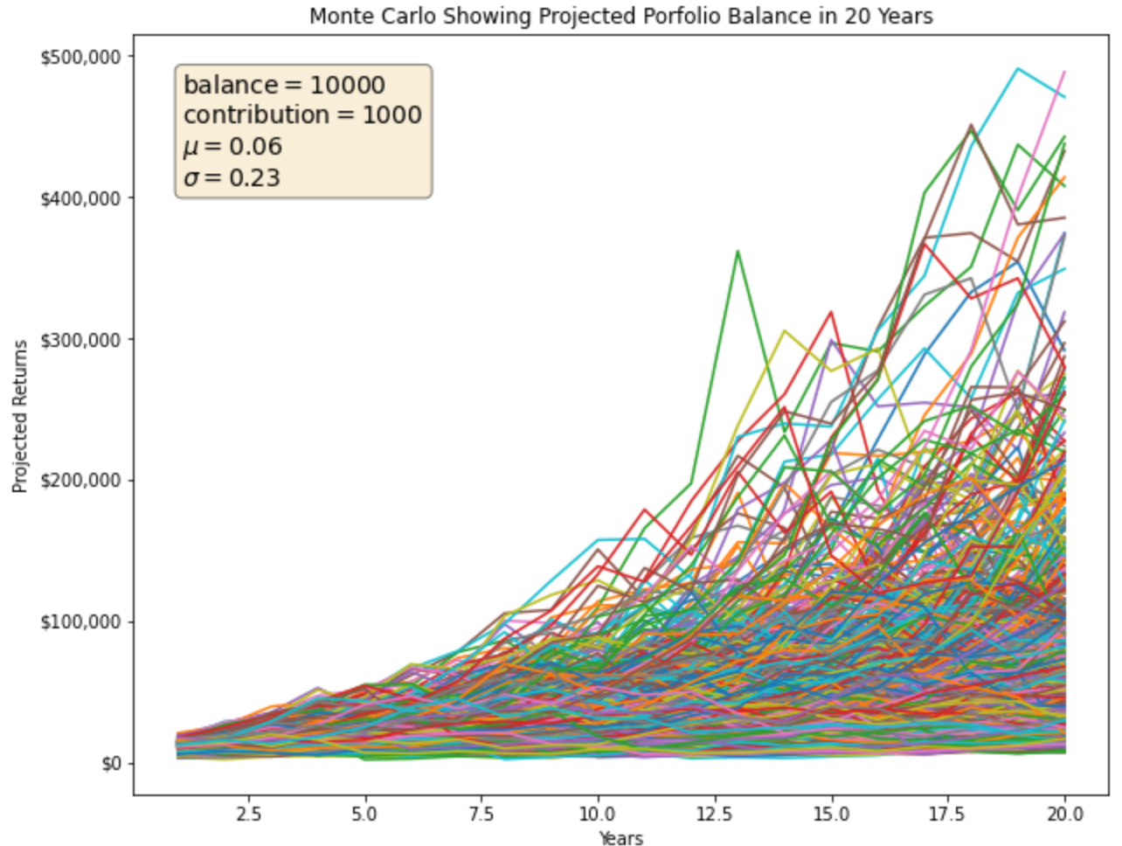
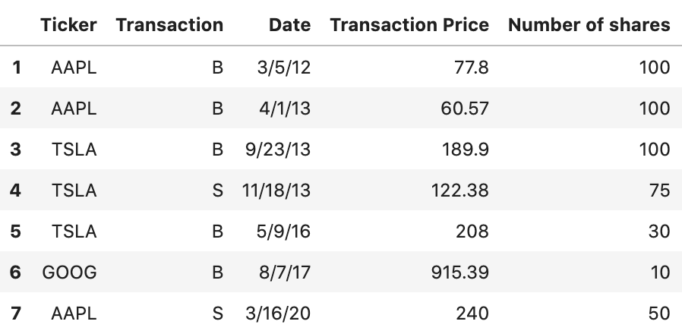
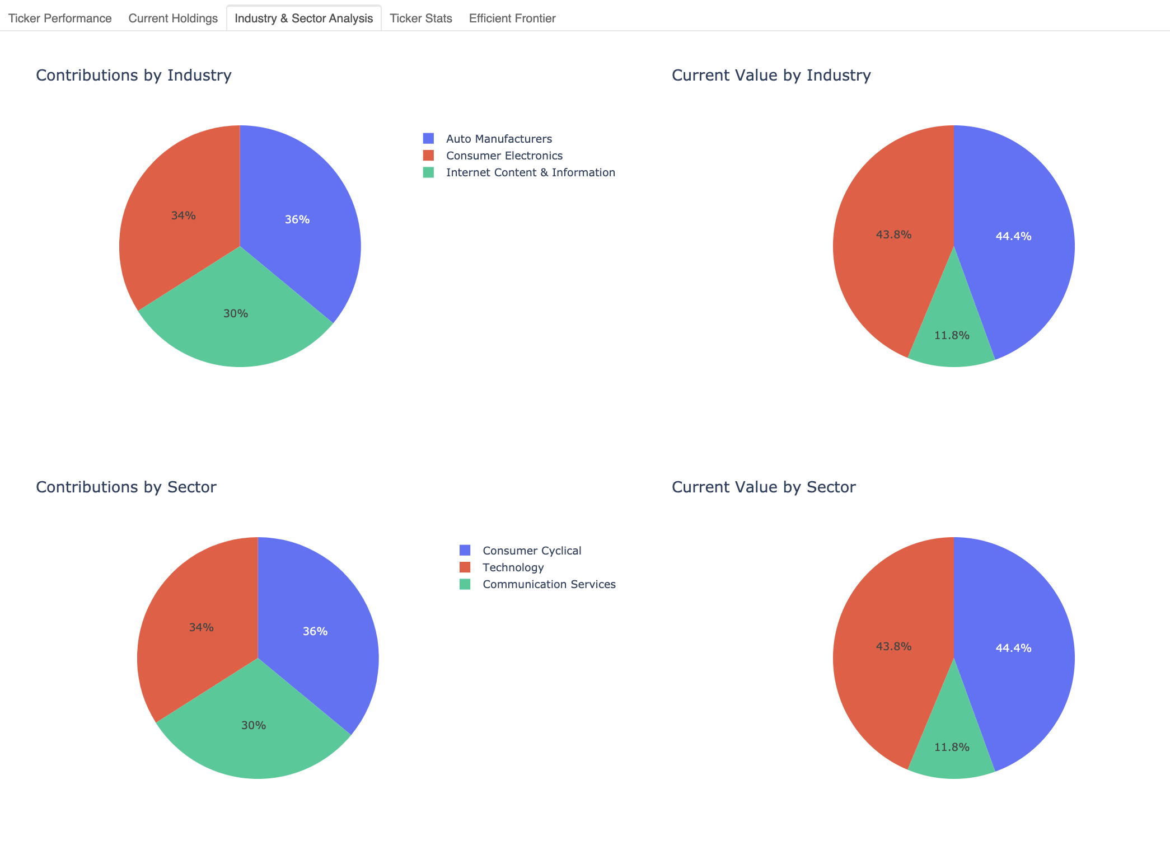
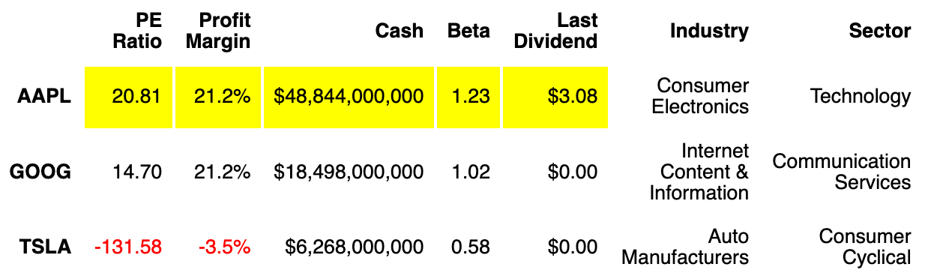
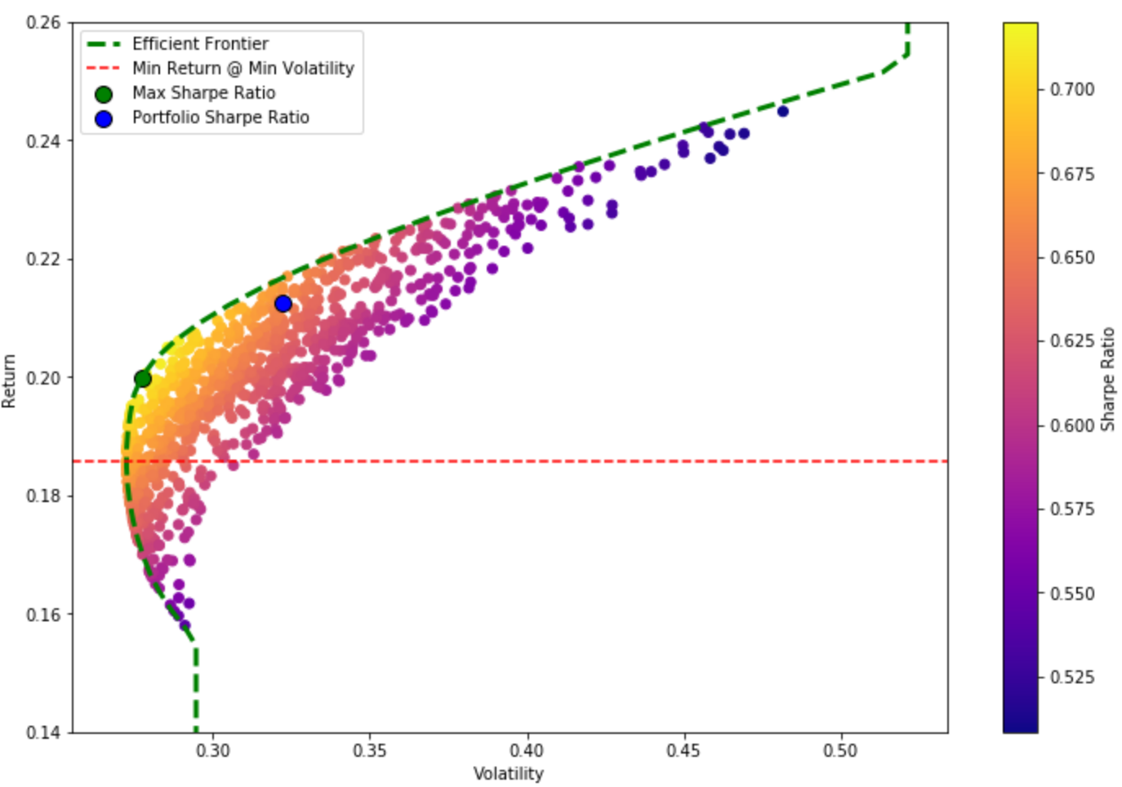

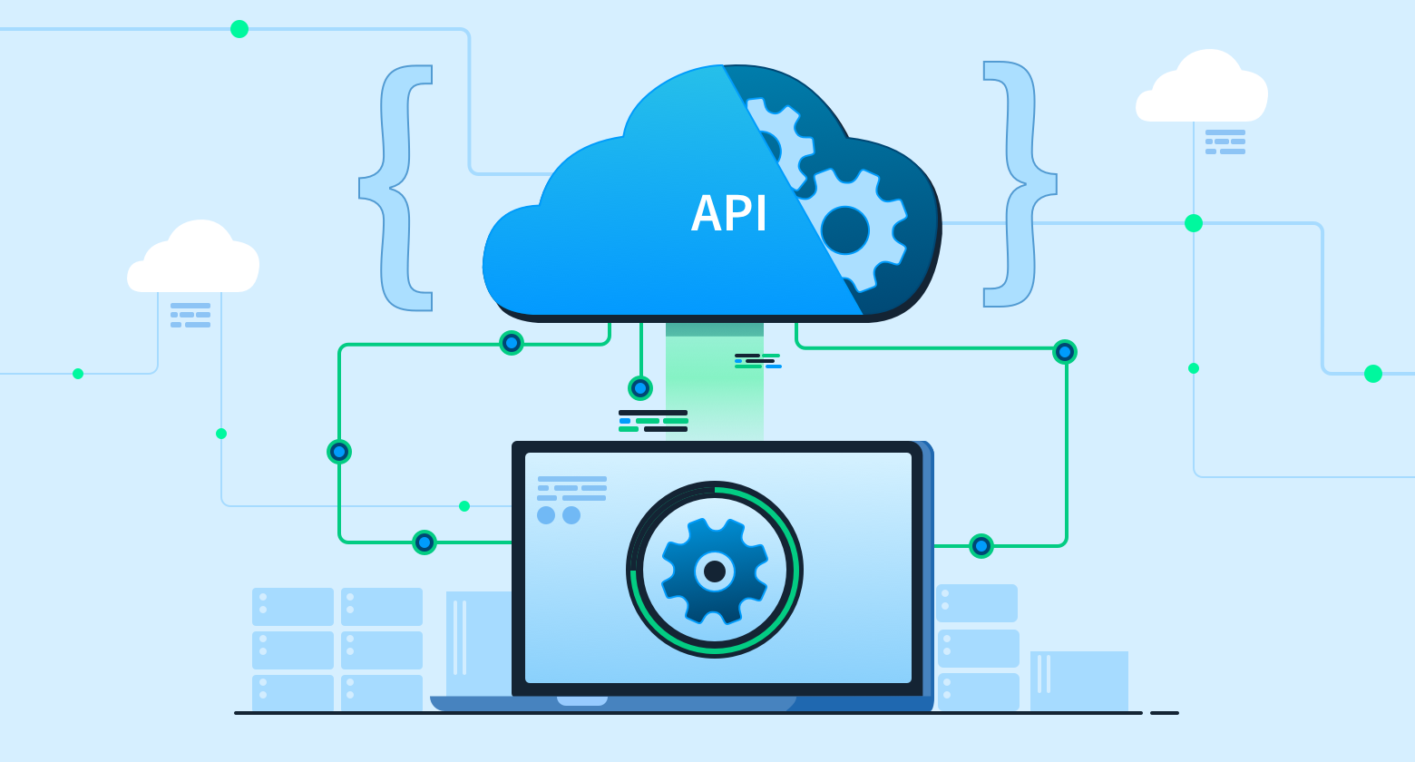
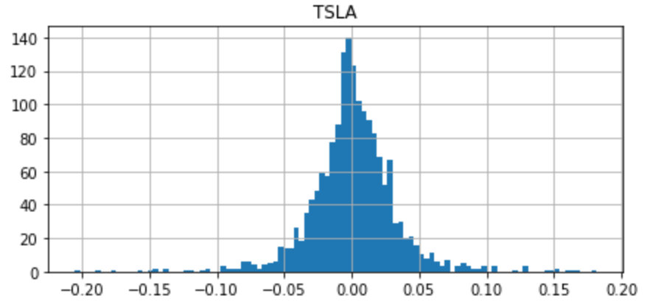
Portfolio Analysis
APIs
User Input
Analysis
Projections

Slide 7
Portfolio Analysis Tools

Slide 8
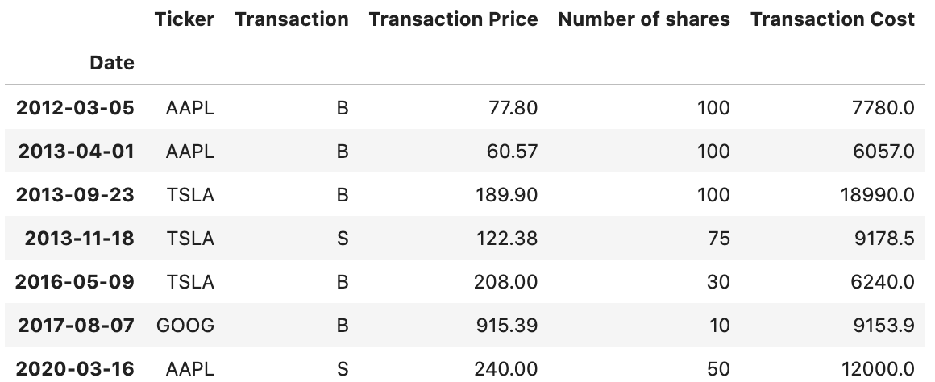
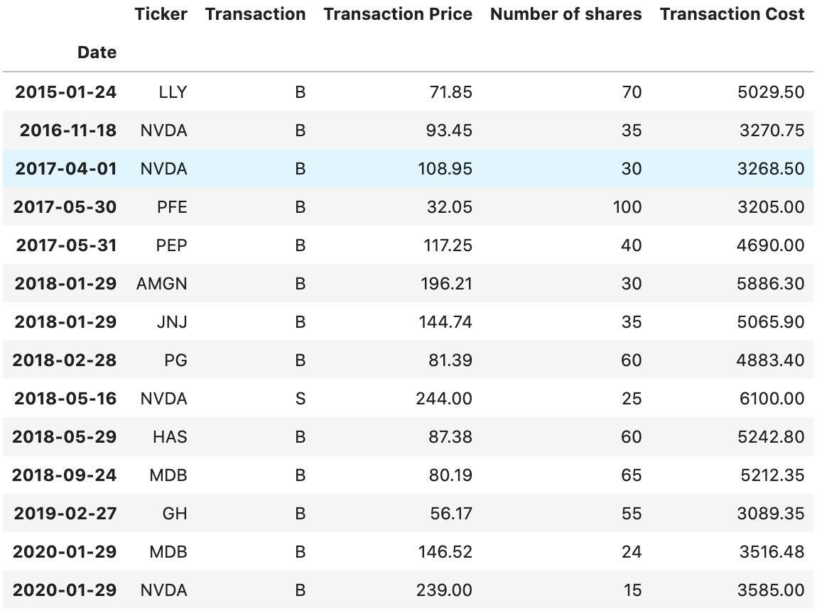
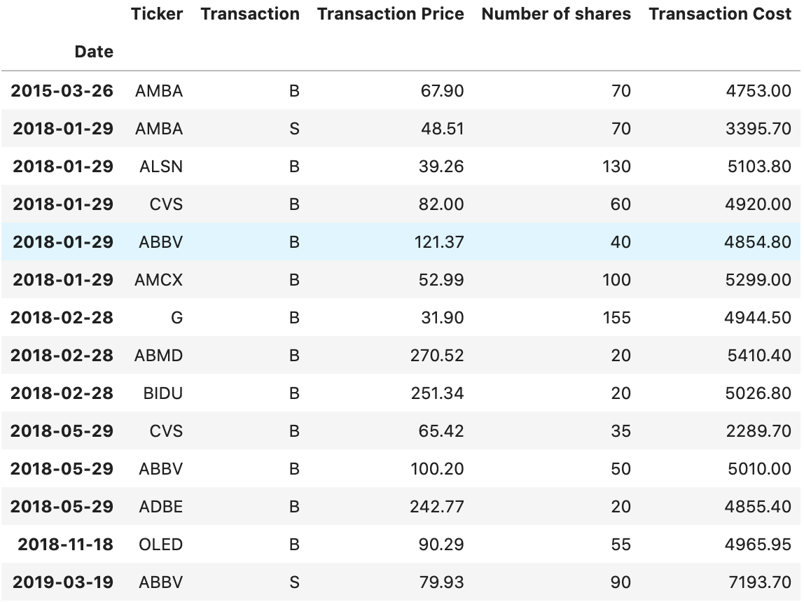
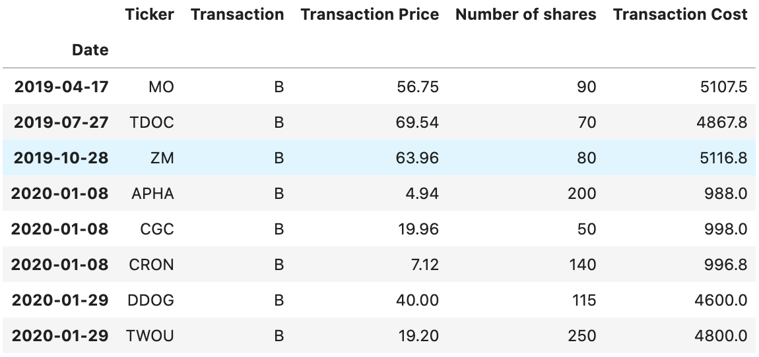
Input Portfolio
Portfolio 1: Growth
Portfolio 3: Income/Growth
Portfolio 2: Growth
Portfolio 4: High Risk

Slide 9
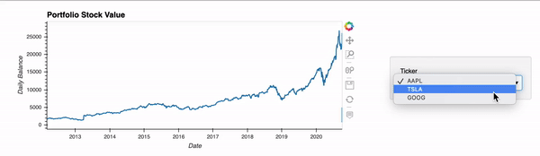
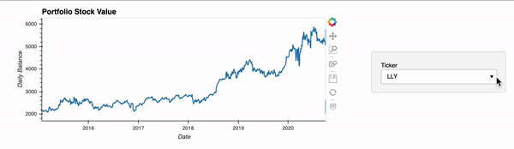
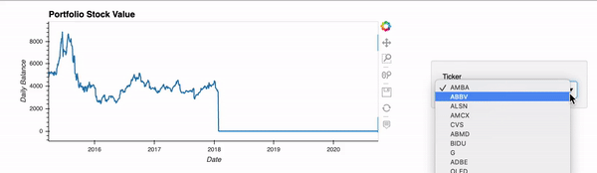
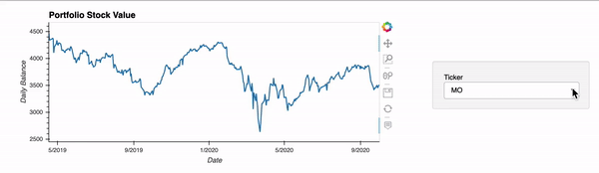
Historical Stock Balance
Portfolio 1: Growth
Portfolio 3: Income/Growth
Portfolio 2: Growth
Portfolio 4: High Risk

Slide 10
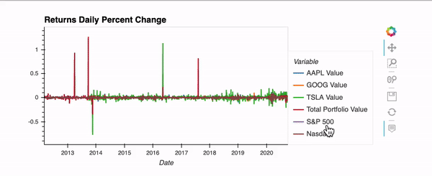
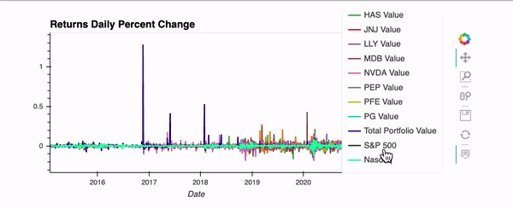
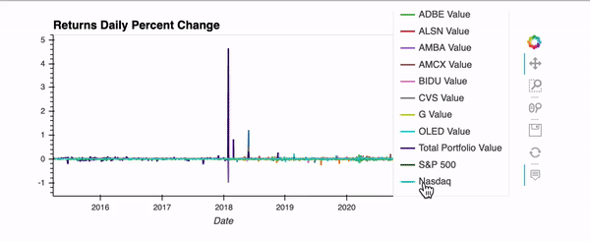
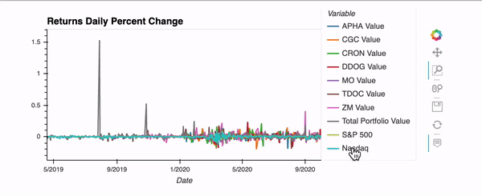
Daily Portfolio/Stock Returns
Portfolio 1: Growth
Portfolio 3: Income/Growth
Portfolio 2: Growth
Portfolio 4: High Risk

Slide 11
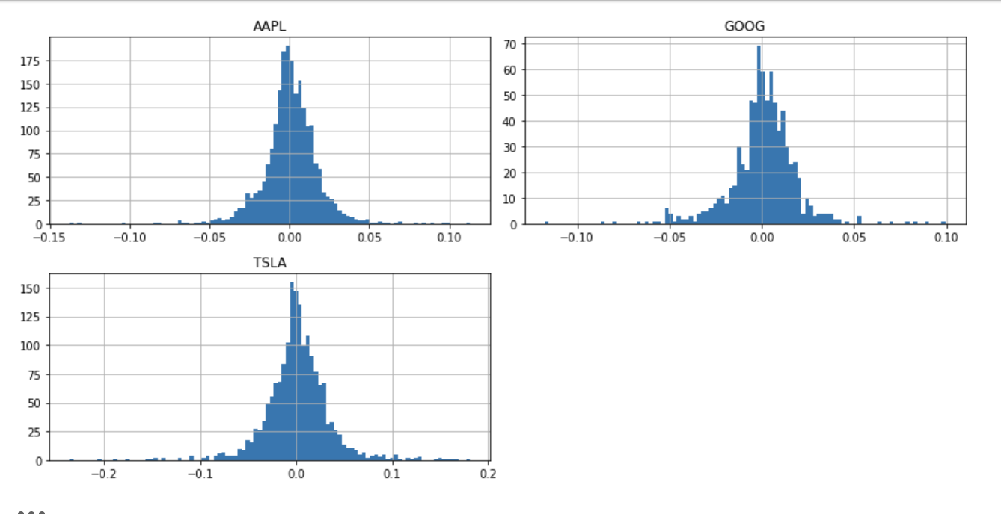
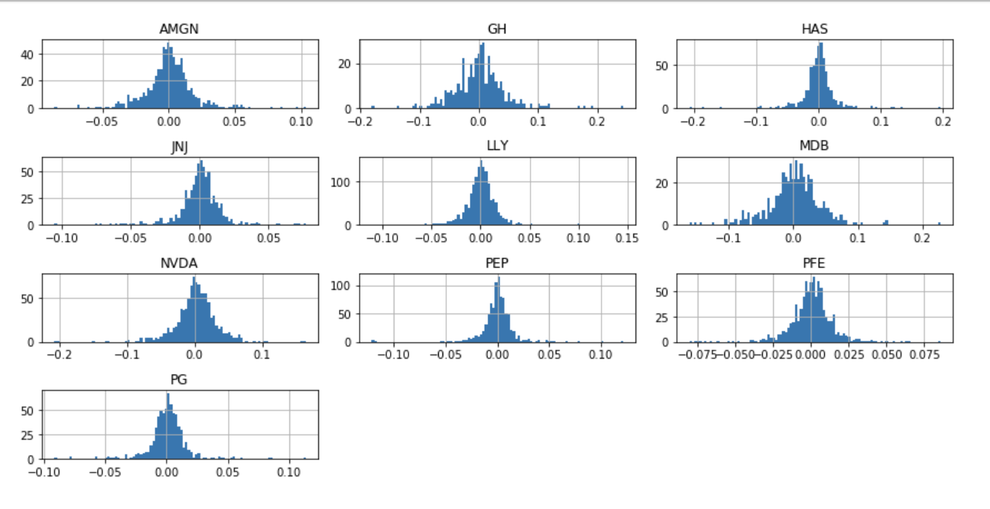
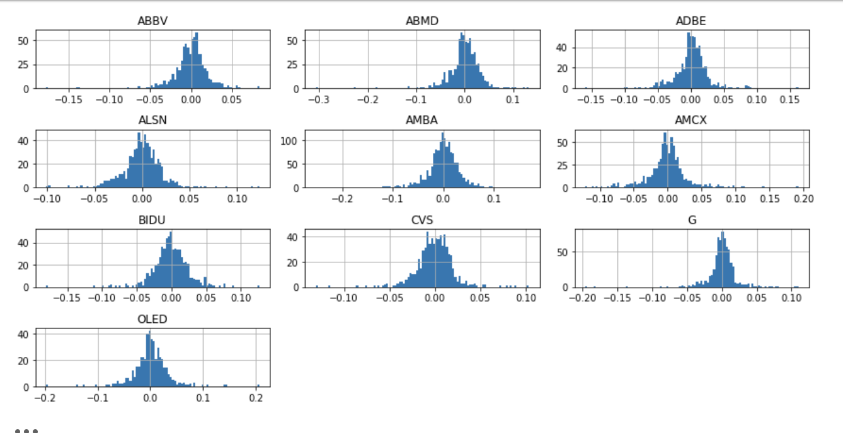
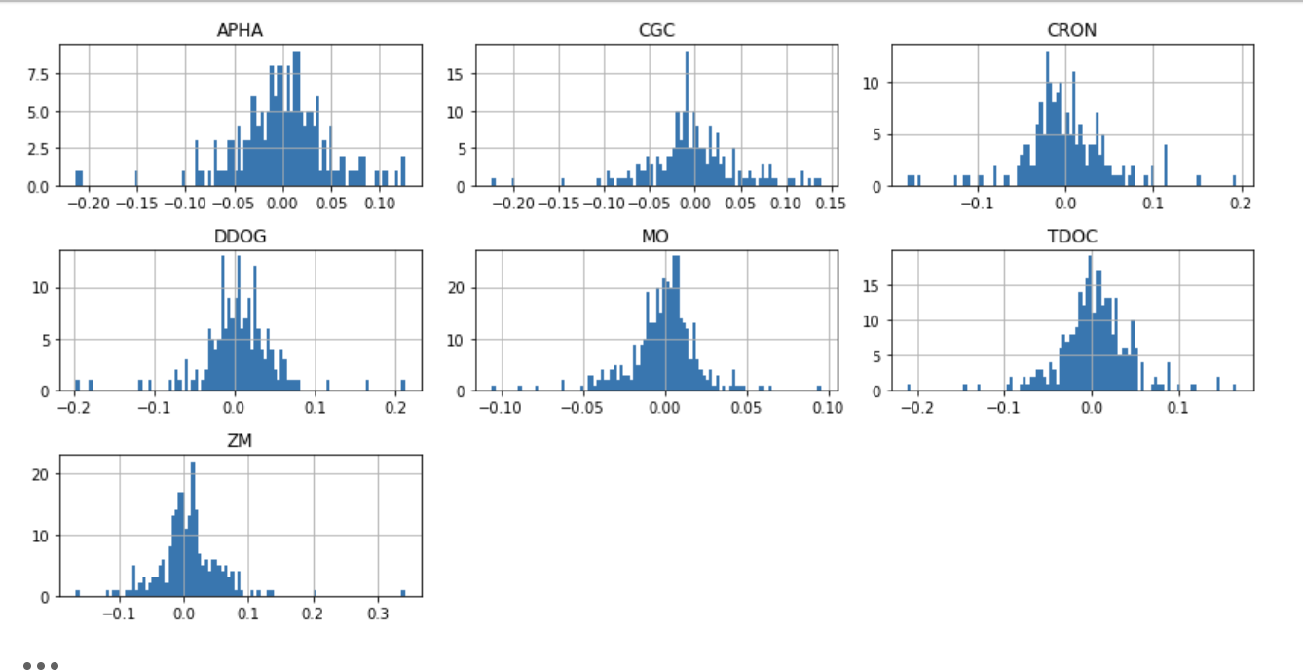
Stock Log Return Histogram
Portfolio 1: Growth
Portfolio 3: Income/Growth
Portfolio 2: Growth
Portfolio 4: High Risk

Slide 12
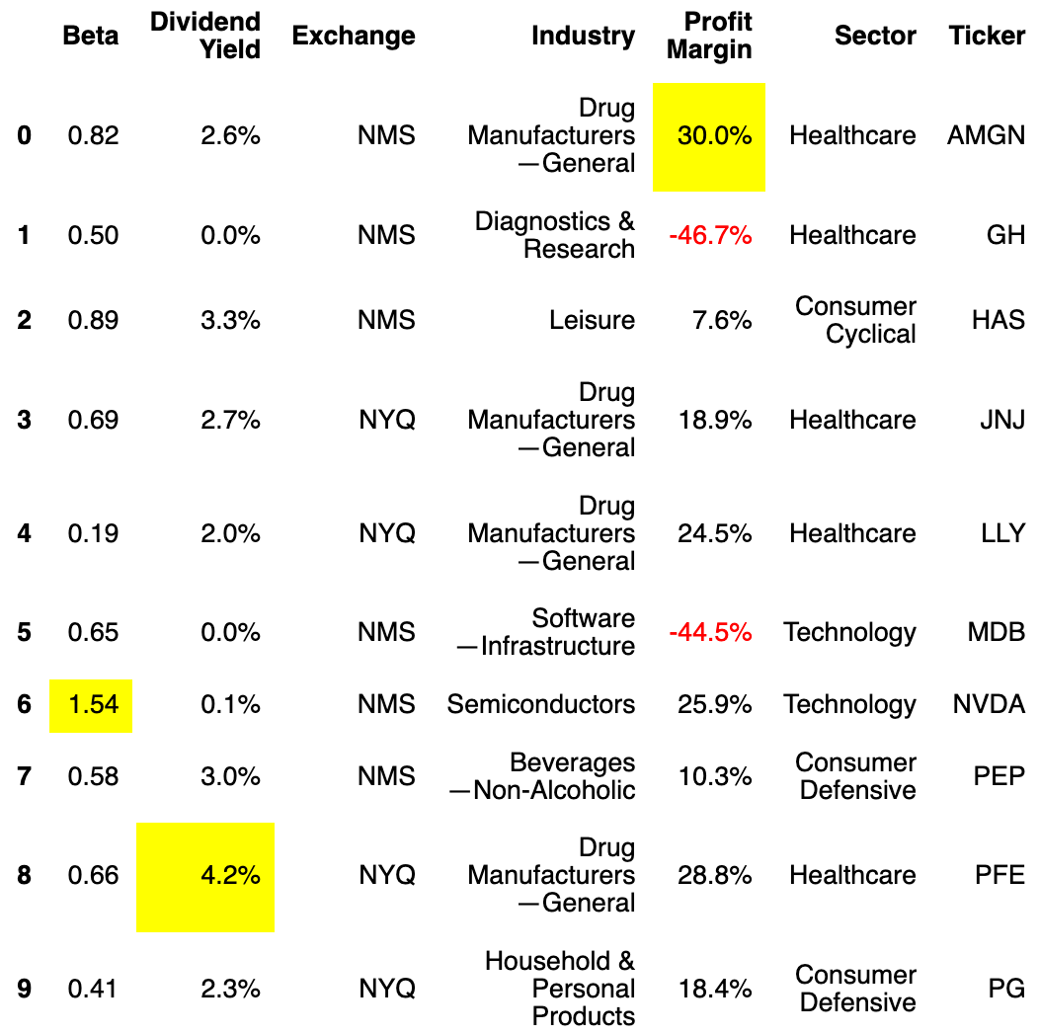
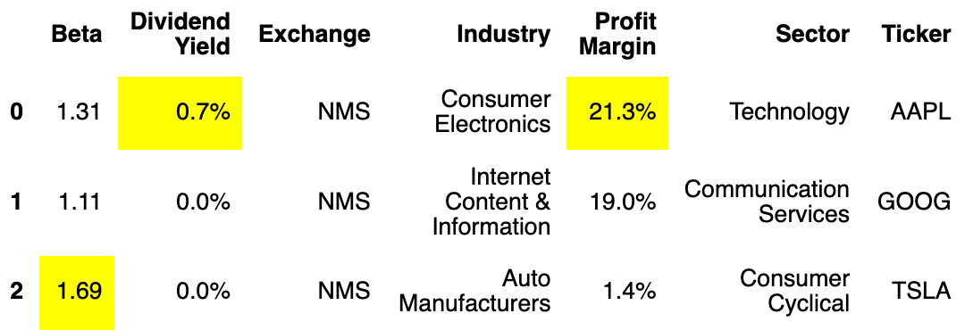
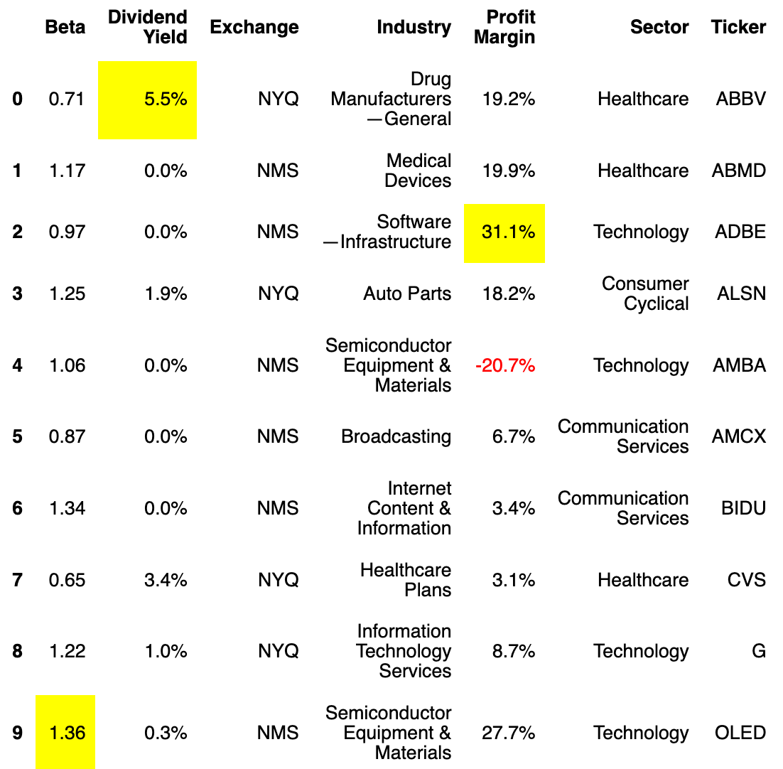
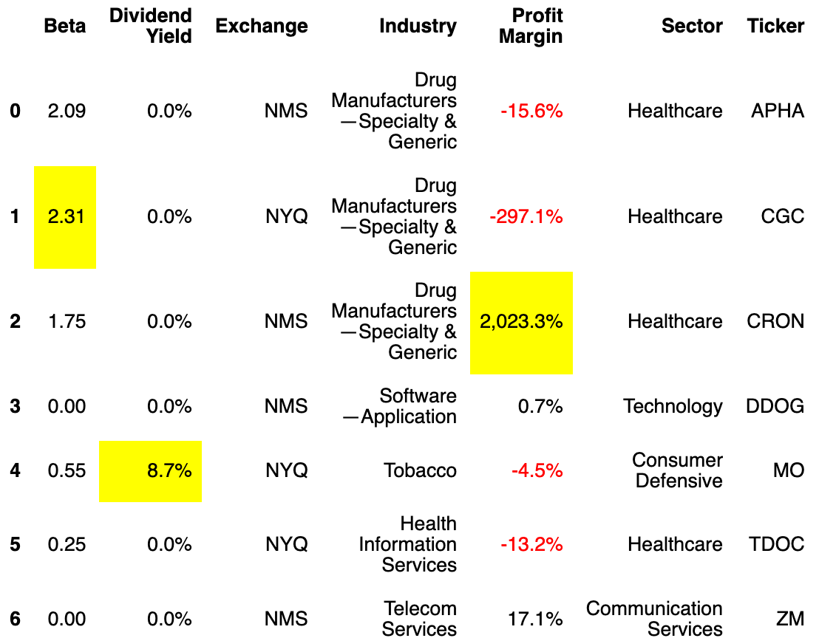
Ticker Stats
Portfolio 1: Growth
Portfolio 3: Income/Growth
Portfolio 2: Growth
Portfolio 4: High Risk

Slide 13
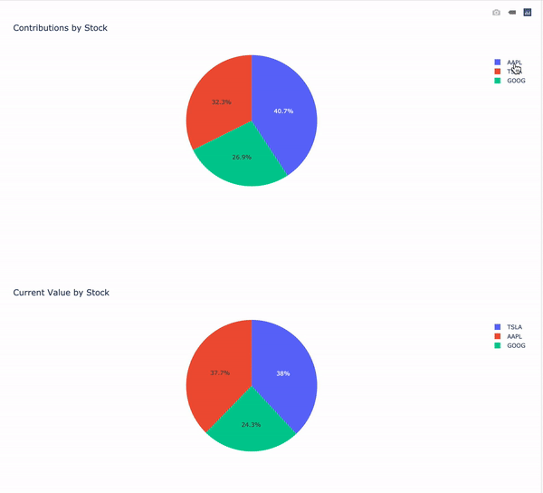
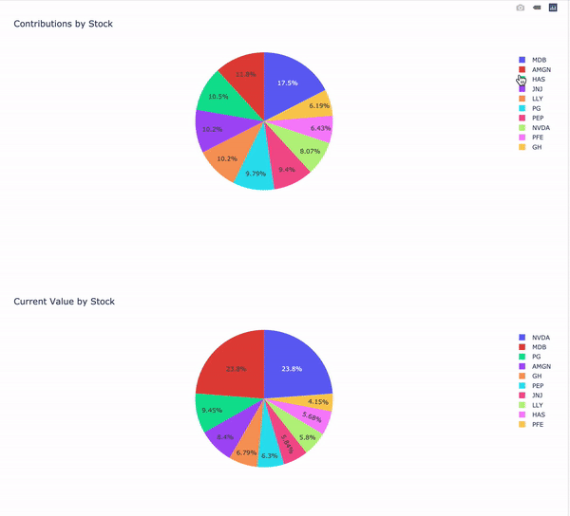
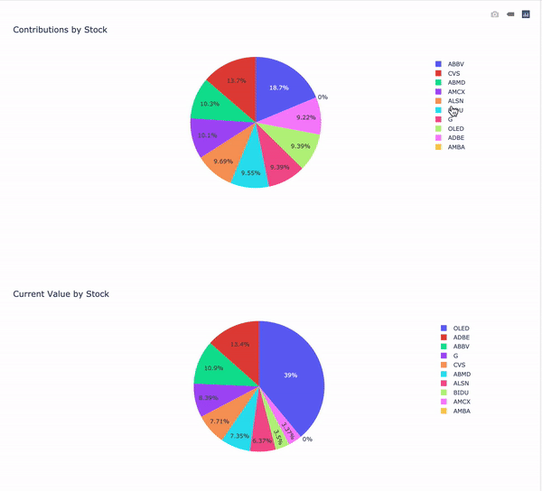
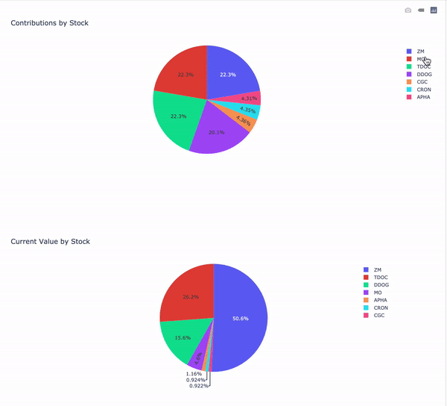
Weighted Holdings
Portfolio 1: Growth
Portfolio 3: Income/Growth
Portfolio 2: Growth
Portfolio 4: High Risk

Slide 14
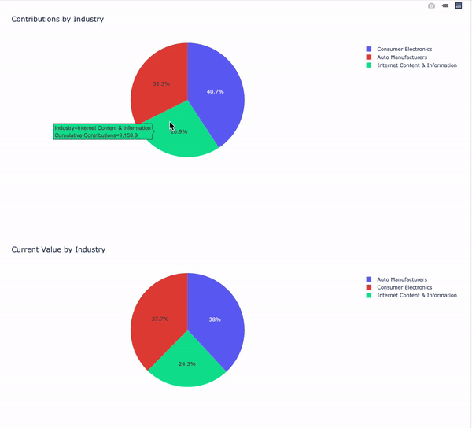
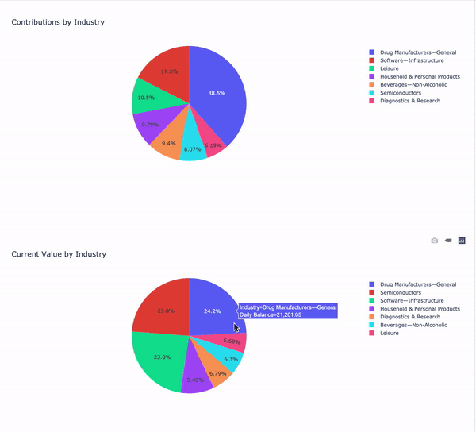
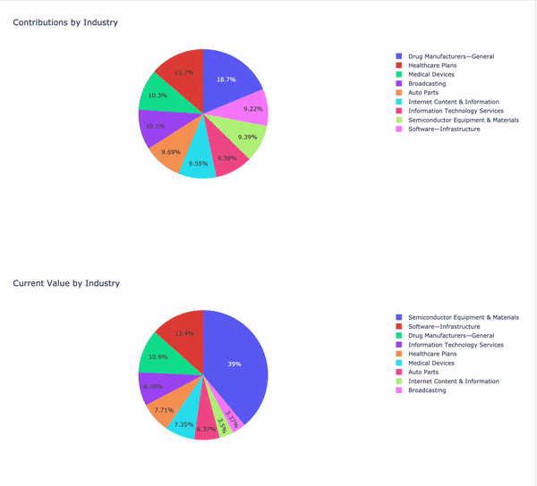
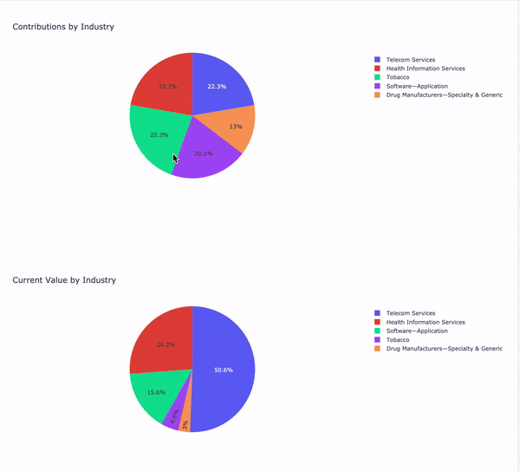
Industry Mix
Portfolio 1: Growth
Portfolio 3: Income/Growth
Portfolio 2: Growth
Portfolio 4: High Risk

Slide 15
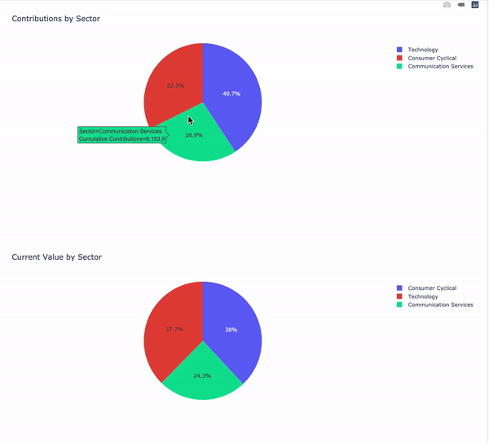
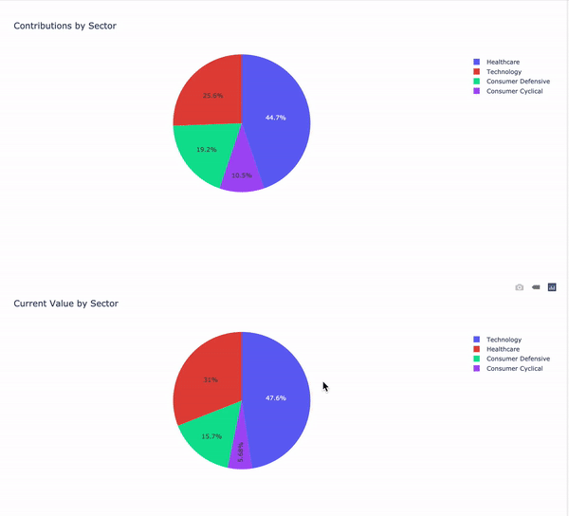
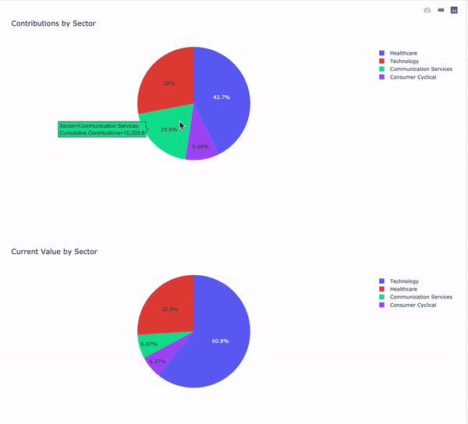
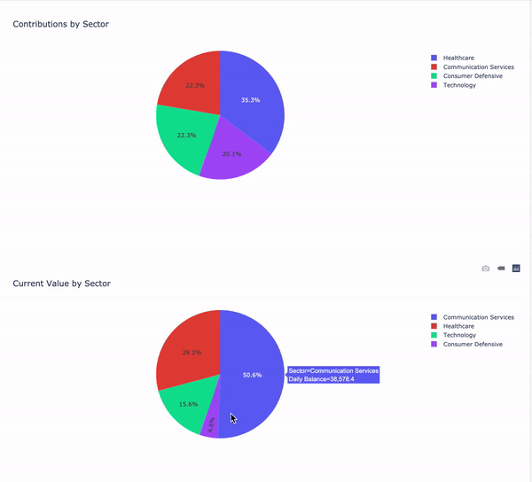
Sector
Portfolio 1: Growth
Portfolio 3: Income/Growth
Portfolio 2: Growth
Portfolio 4: High Risk

Slide 16
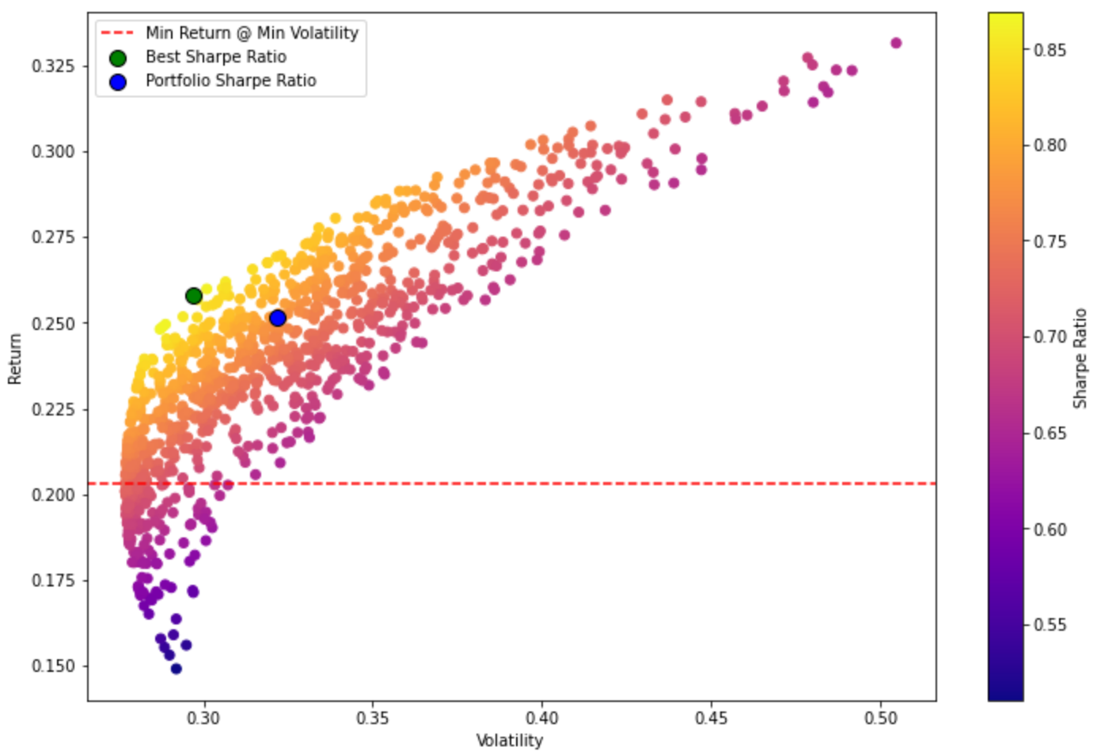
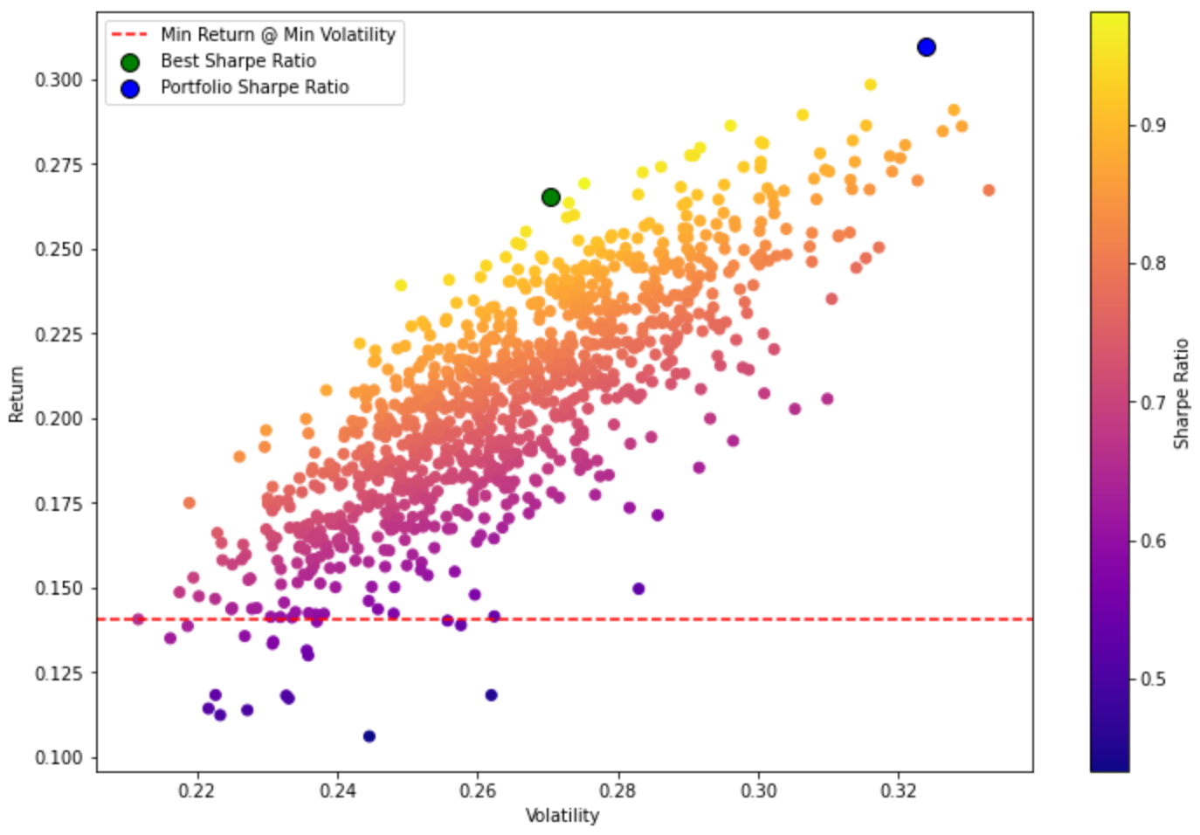
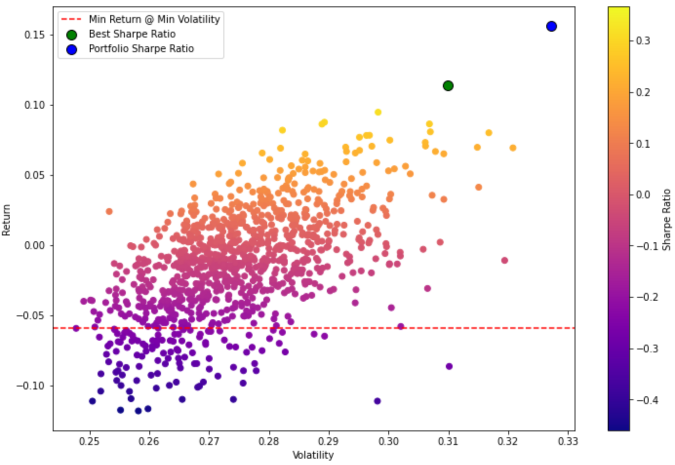
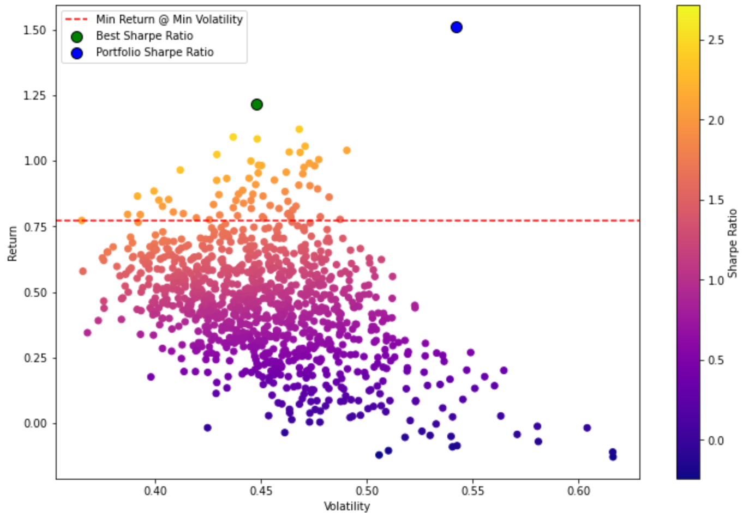
Efficient Frontier
Portfolio 1: Growth
Portfolio 3: Income/Growth
Portfolio 2: Growth
Portfolio 4: High Risk

Slide 17
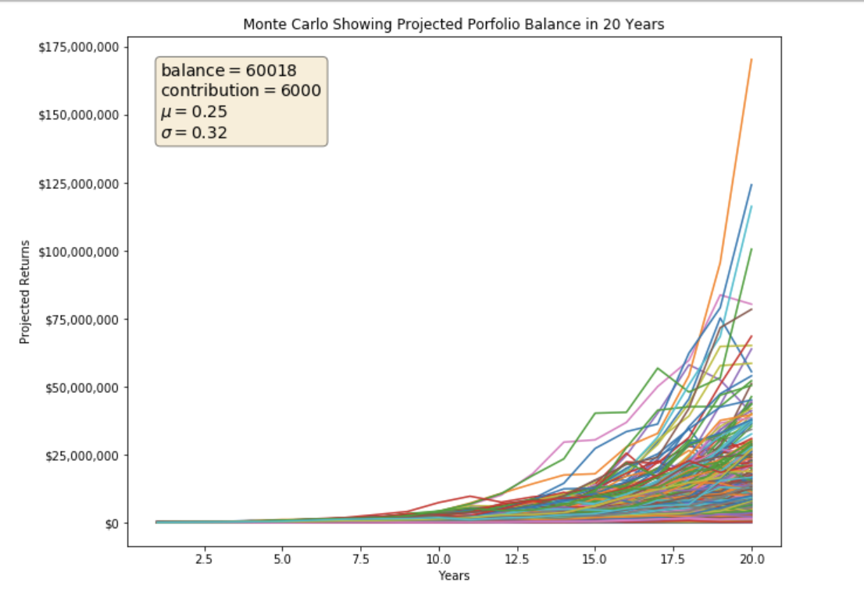
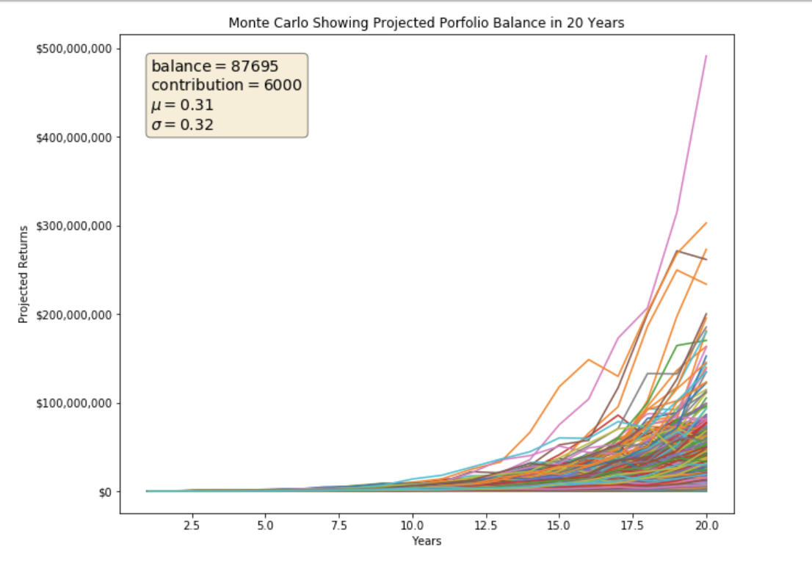
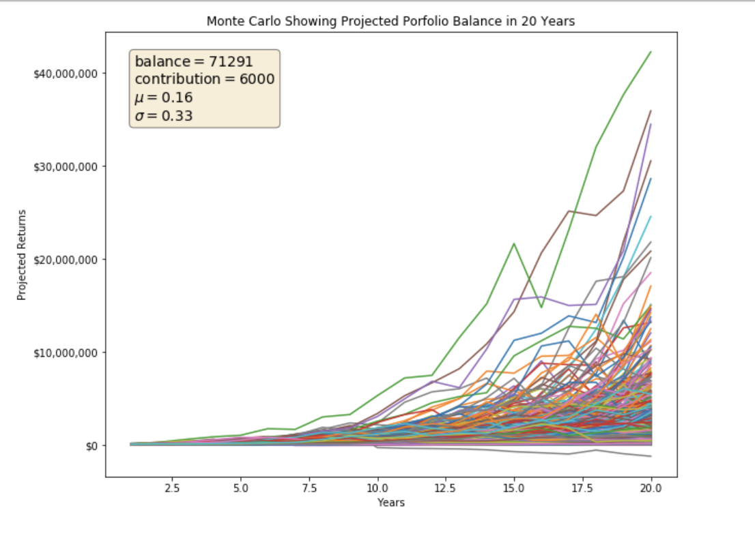
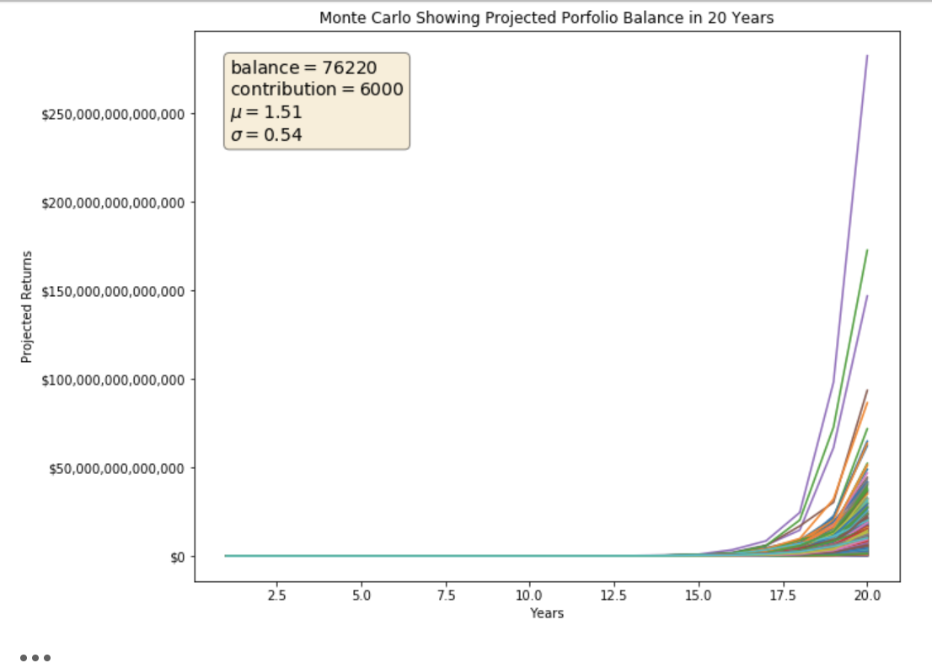
20-Year Balance Projection
Portfolio 1: Growth
Portfolio 3: Income/Growth
Portfolio 2: Growth
Portfolio 4: High Risk

Slide 18
Robo Advisor

Slide 19
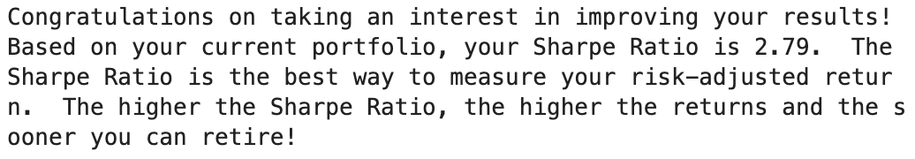
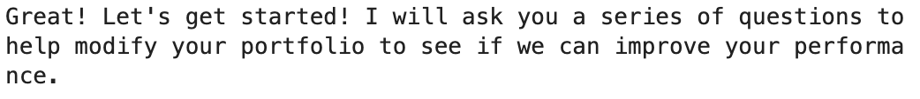




Portfolio 4: High Risk
New Input

Slide 20


Robo Analysis
Portfolio 4: Current Analysis
Portfolio 4: Robo Analysis

Slide 21
Thank You

